Slide 1

Software Engineering
08: Agile Development
Dr. Seyed Reza Shahamiri More Info

Slide 2

Introduction
2
Rapid development and delivery is now often the most critical requirement for software systems.
In fact, many businesses are willing to trade off software quality and compromise on requirements to achieve faster deployment of the software that they need.
Software development processes that plan on completely specifying the requirements and then designing, building, and testing the system are not geared to rapid software development.

Slide 3
Rapid Software Development
3
For some types of software, such as safety-critical control systems, where a complete analysis of the system is essential, a plan-driven approach is the right one.
However, in a fast-moving business environment, this can cause real problems:
By the time the software is available for use, the original reason for its procurement may have changed so radically that the software is effectively useless.
Therefore, for business systems in particular, development processes that focus on rapid software development and delivery are essential.

Slide 4
Rapid Software Development
4
Rapid software development processes are designed to produce useful software quickly.
The software is not developed as a single unit but as a series of increments, with each increment including new system functionality.

Slide 5
Rapid Software Development Characteristics
5
The processes of specification, design, and implementation are interleaved.
There is no detailed system specification, and design documentation is minimized (not ignored!) or generated automatically.
The user requirements document only defines the most important characteristics of the system.
The system is developed in a series of versions.
System user interfaces are often developed using an interactive development system that allows the interface design to be quickly created by drawing and placing UI libraries on the interface.

Slide 6
Agile
6
Plan driven approaches involve a significant overhead in planning, designing, and documenting the system.
This overhead is, however, justified when the work of multiple development teams has to be coordinated, when the system is a critical system, and when many different people will be involved in maintaining the software over its lifetime.
On the other hand, when this heavyweight, plan-driven development approach is applied to small and medium-sized business systems, the overhead involved is so large that it dominates the software development process.

Slide 7
Agile
7
Dissatisfaction with these heavyweight approaches to software engineering led a number of software developers in the 1990s to propose new ‘agile methods’.
These allowed the development team to focus on the software itself rather than on its design and documentation.
Agile software development is a group of software development methods in which requirements and solutions evolve through collaboration between self-organizing, cross-functional teams.

Slide 8
Agile
8
Agile methods are incremental development methods in which the increments are small and, typically, new releases of the system are created and made available to customers every two or three weeks.
They involve customers in the development process to get rapid feedback on changing requirements.
They minimize documentation by using informal communications rather than formal meetings with written documents.

Slide 9
Agile
9
Agile approaches to software development consider design and implementation to be the central activities in the software process.
They incorporate other activities, such as requirements elicitation and testing, into design and implementation.

Slide 10
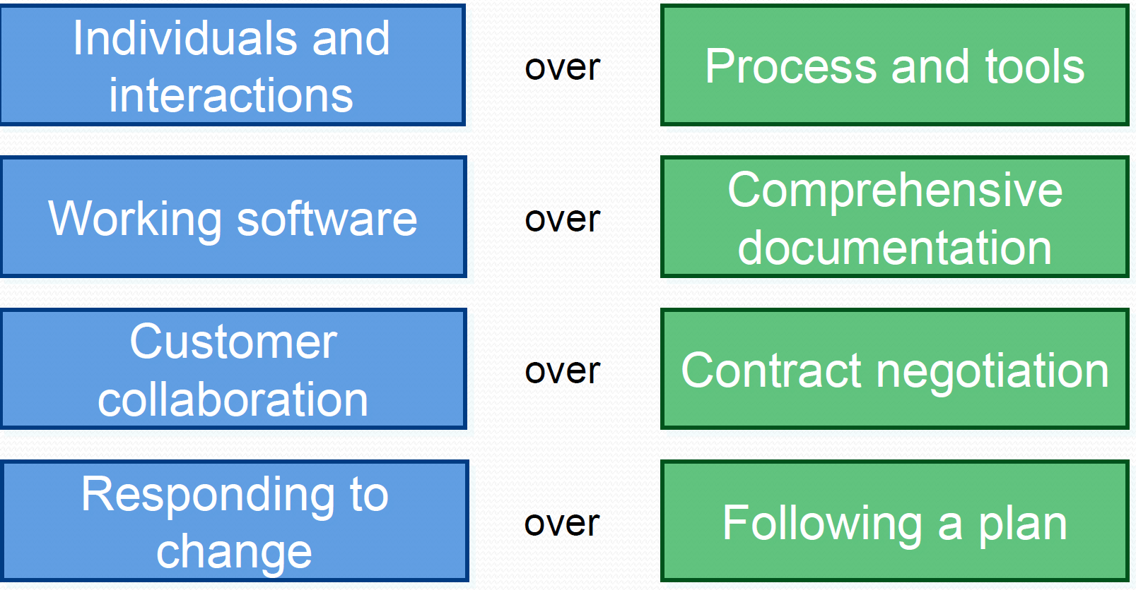
Agile Manifesto
10
“We are uncovering better ways of developing software by doing it and helping others do it. Through this work we have come to value:
That is, while there is value in the items on the right, we value the items on the left more.”

Slide 11
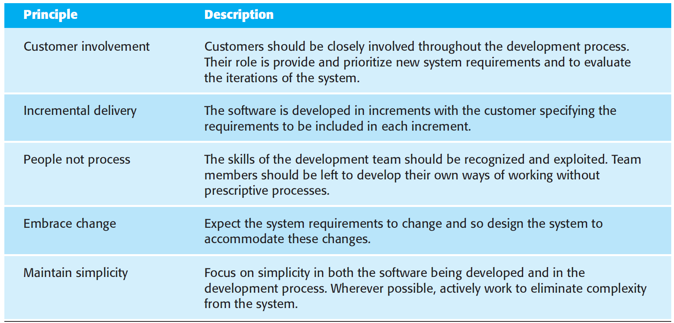
Agile Principles
11

Slide 12
Agile Principles Class Activity
12
Discuss in the class the difficulties that may raise as a result of applying Agile Manifesto and principles in software development.

Slide 13
Agile Principles Difficulties
13
Success in customer involvement in the development process depends on having a customer who is willing and able to spend time with the development team and who can represent all system stakeholders!
Individual team members may not have suitable personalities for the intense involvement in agile methods, and therefore not interact well with other team members.
Prioritizing changes can be extremely difficult as, typically, each stakeholder gives different priorities to different changes.

Slide 14
Agile Principles Difficulties
14
Maintaining simplicity requires extra work. Under pressure from delivery schedules, the team members may not have time to carry out desirable system simplifications.
Many organizations have spent years changing their culture so that processes are defined and followed. It is difficult for them to move to a working model in which processes are informal and defined by development teams.

Slide 15
Agile Contracts
15
Agile methods have to rely on contracts in which the customer pays for the time required for system development rather than the development of a specific set of requirements.
If problems arise then there may be difficult disputes over who is to blame and who should pay for the extra time and resources required to resolve the problems.

Slide 16
Agile vs Plan-Driven vs Formal Development
16
Agile methods | Plan-driven methods | Formal methods
Low criticality | High criticality | Extreme criticality
Senior developers | Junior developers(?) | Senior developers
Requirements change often | Requirements do not change often | Limited requirements, limited features
Small number of developers | Large number of developers | Requirements that can be modeled
Culture that responds to change | Culture that demands order | Extreme quality

Slide 17
Agile Methods
17
Extreme Programming (XP)
Scrum
Feature Driven Development (FDD)
Adaptive Software Development (ASD)
Agile Modeling
Agile Unified Process (AUP)
Crystal Methods (Crystal Clear)
Disciplined Agile Delivery
Lean software development
Kanban (development)
Dynamic Systems Development Method (DSDM)

Slide 18
Agile Methods Extreme Programming (XP)
18
In extreme programming, requirements are based on simple customer stories or scenarios (called user stories) that are used as a basis for deciding what functionality should be included in a system increment.
User stories are implemented directly as a series of tasks.
Programmers work in pairs and develop tests for each task before writing the code.
All tests must be successfully executed when new code is integrated into the system.
There is a short time gap between releases of the system.

Slide 19
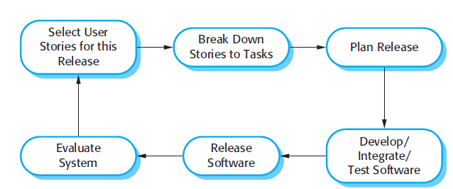
Agile Methods Extreme Programming (XP) Process
19

Slide 20
Agile Methods Extreme Programming (XP) Principles
20
1 - Incremental planning:
Requirements are recorded on Story Cards and the Stories to be included in a release are determined by the time available and their relative priority.
The developers break these Stories into development ‘Tasks’.
2 - Small releases:
The minimal useful set of functionality that provides business value is developed first.
Releases of the system are frequent and incrementally add functionality to the first release.

Slide 21
Agile Methods Extreme Programming (XP) Principles
21
3 - Simple design:
Enough design is carried out to meet the current requirements and no more.
4 - Test-first development:
An automated unit test framework is used to write tests for a new piece of functionality before that functionality itself is implemented.
5 – Refactoring:
All developers are expected to refactor the code continuously as soon as possible code improvements are found.
This keeps the code simple and maintainable.

Slide 22
Agile Methods Extreme Programming (XP) Principles
22
6 - Pair programming:
Developers work in pairs, checking each other’s work and providing the support to always do a good job.
7 - Collective ownership:
The pairs of developers work on all areas of the system, so that no islands of expertise develop and all the developers take responsibility for all of the code.
Anyone can change anything.

Slide 23
Agile Methods Extreme Programming (XP) Principles
23
8 - Continuous integration:
As soon as the work on a task is complete, it is integrated into the whole system.
After any such integration, all the unit tests in the system must pass.
9 - Sustainable pace:
Large amounts of overtime are not considered acceptable as the net effect is often to reduce code quality and medium term productivity.

Slide 24
Agile Methods Extreme Programming (XP) Principles
24
10 - On-site customer:
A representative of the end-user of the system (the Customer) should be available full time for the use of the XP team.
In an extreme programming process, the customer is a member of the development team and is responsible for bringing system requirements to the team for implementation.

Slide 25
Agile Methods Extreme Programming (XP) Story Card
25
In an XP process, customers are intimately involved in specifying and prioritizing system requirements.
The requirements are not specified as lists of required system functions. Rather, the system customer is part of the development team and discusses scenarios with other team members.
Together, they develop a ‘story card’ that encapsulates the customer needs.
The development team then aims to implement that scenario in a future release of the software.
The story cards are the main inputs to the XP planning process or the ‘planning game’.

Slide 26
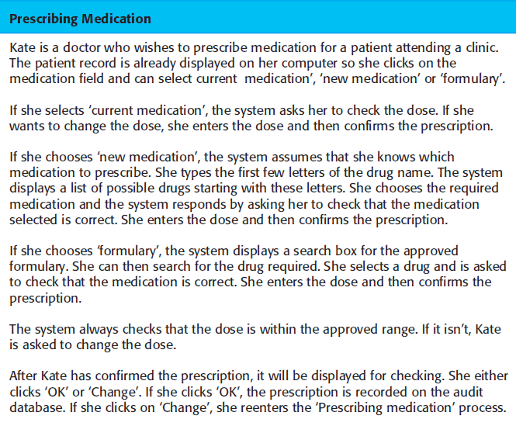
Agile Methods Extreme Programming (XP) Story Card: Example
26

Slide 27
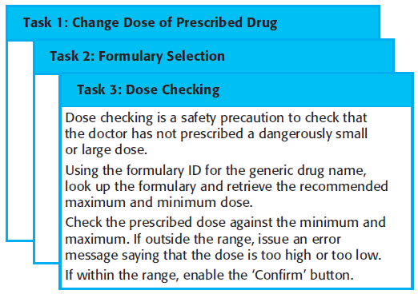
Agile Methods Extreme Programming (XP) Tasks: Example
27
Once the story cards have been developed, the development team breaks these down into tasks and estimates the effort and resources required for implementing each task.

Slide 28
Agile Methods Extreme Programming (XP) Planning Game
28
The customer then prioritizes the stories for implementation, choosing those stories that can be used immediately to deliver useful business support.
As requirements change, the unimplemented stories change or may be discarded.
If changes are required for a system that has already been delivered, new story cards are developed and again, the customer decides whether these changes should have priority over new functionality.

Slide 29
Agile Methods Extreme Programming (XP) Planning Game: Spike
29
Sometimes, during the planning game, questions that cannot be easily answered come to light and additional work is required to explore possible solutions.
The team may carry out some prototyping or trial development to understand the problem and solution.
In XP terms, this is a ‘spike’: an increment where no programming is done.
There may also be ‘spikes’ to design the system architecture or to develop system documentation.

Slide 30
Agile Methods Extreme Programming (XP) Planning Game
30
Release deadlines are never slipped:
if there are development problems, the customer is consulted and functionality is removed from the planned release.

Slide 31
Agile Methods Extreme Programming (XP) Refactoring
31
A general problem with incremental development is that it tends to degrade the software structure, so changes to the software become harder and harder to implement.
Essentially, the development proceeds by finding workarounds to problems, with the result that code is often duplicated, parts of the software are reused in inappropriate ways, and the overall structure degrades as code is added to the system.

Slide 32
Agile Methods Extreme Programming (XP) Refactoring
32
XP tackles this problem by suggesting that the software should be constantly refactored:
This means that the programming team look for possible improvements to the software and implement them immediately.
When a team member sees code that can be improved, they make these improvements even in situations where there is no immediate need for them.
Examples of refactoring include the reorganization of a class hierarchy to remove duplicate code, the tidying up and renaming of attributes and methods, and the replacement of code with calls to methods defined in a program library.

Slide 33
Agile Methods Extreme Programming (XP) Testing
33
The key features of testing in XP are:
Test-first development,
incremental test development from scenarios,
user involvement in the test development and validation, and
the use of automated testing frameworks.
In test-first development, the task implementers have to thoroughly understand the specification so that they can write tests for the system.
This means that ambiguities and omissions in the specification have to be clarified before implementation begins.

Slide 34
Agile Methods Extreme Programming (XP) Testing
34
The role of the customer in the testing process is to help develop acceptance tests for the stories that are to be implemented in the next release of the system.
Acceptance testing is the process where the system is tested using customer data to check that it meets the customer’s real needs.
Test automation is essential for test-first development.
An automated test framework, such as Junit or VS Test Tools, is a system that makes it easy to write executable tests and submit a set of tests for execution.

Slide 35
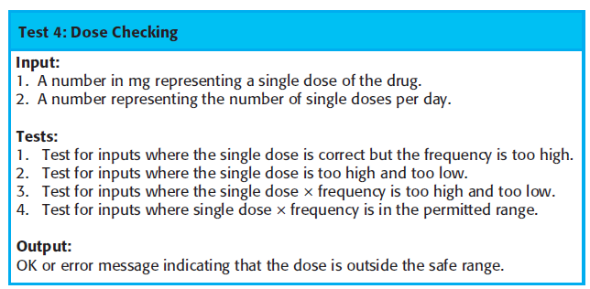
Agile Methods Extreme Programming (XP) Testing: Test Case Example
35
A test case that has been developed to check that the prescribed dose of a drug does not fall outside known safe limits:

Slide 36
Agile Methods Extreme Programming (XP) Pair-Programming
36
Programmers work in pairs to develop the software.
They actually sit together at the same workstation to develop the software.
However, the same pairs do not always program together. Rather, pairs are created dynamically so that all team members work with each other during the development process.

Slide 37
Agile Methods Extreme Programming (XP) Class activity
37
Discuss in the class the pros and cons of pair programming in XP. Do you find it useful, or do you consider it as a waste of resources?

Slide 38
Agile Methods Extreme Programming (XP) Pair-Programming: Benefits
38
It supports the idea of collective ownership and responsibility for the system. The software is owned by the team as a whole and individuals are not held responsible for problems with the code. Instead, the team has collective responsibility for resolving these problems.
It acts as an informal review process because each line of code is looked at by at least two people.
It helps support refactoring, which is a process of software improvement.

Slide 39
Agile Methods Extreme Programming (XP) Pair-Programming: Benefits
39
Pairs discuss the software before development so probably they have fewer false starts and less rework.
The number of errors avoided by the informal inspection is such that less time is spent repairing bugs discovered during the testing process.
If the programmers are not well experienced, pair-programming can effectively improve the overall productivity. But for experienced programmers, the productivity is reduced.

Slide 40
Agile Methods Scrum
40
Scrum focuses on managing iterative development rather than specific technical approaches to agile software engineering.
To put it differently, it’s an agile project management approach. It provides agile management framework.
Scrum does not prescribe the use of programming practices such as pair programming and test-first development.
It can therefore be used with more technical agile approaches, such as XP, to provide a management framework for the project.

Slide 41
Agile Methods Scrum Phases
41
There are three phases in Scrum:
The first is an outline planning phase where you establish the general objectives for the project and design the software architecture.
This is followed by a series of sprint cycles, where each cycle develops an increment of the system.
Finally, the project closure phase wraps up the project, completes required documentation such as system help frames and user manuals, and assesses the lessons learned from the project.

Slide 42
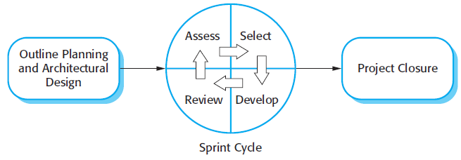
Agile Methods Scrum Phases
42

Slide 43
Agile Methods Scrum Sprint Cycles
43
The innovative feature of Scrum is its central phase, namely the sprint cycles with the following characteristics:
Sprints are fixed length, normally 2–4 weeks. They correspond to the development of a release of the system in XP.
The starting point for planning is the product backlog, which is the list of work to be done on the project.
The selection phase involves all of the project team who work with the customer to select the features and functionality to be developed during the sprint.

Slide 44
Agile Methods Scrum Sprint Cycles
44
The innovative feature of Scrum is its central phase, namely the sprint cycles with the following characteristics:
Once these are agreed, the team organizes themselves to develop the software. During this stage the team is isolated from the customer and the organization, with all communications channelled through the so-called ‘Scrum master’. The role of the Scrum master is to protect the development team from external distractions.
At the end of the sprint, the work done is reviewed and presented to stakeholders. The next sprint cycle then begins.

Slide 45
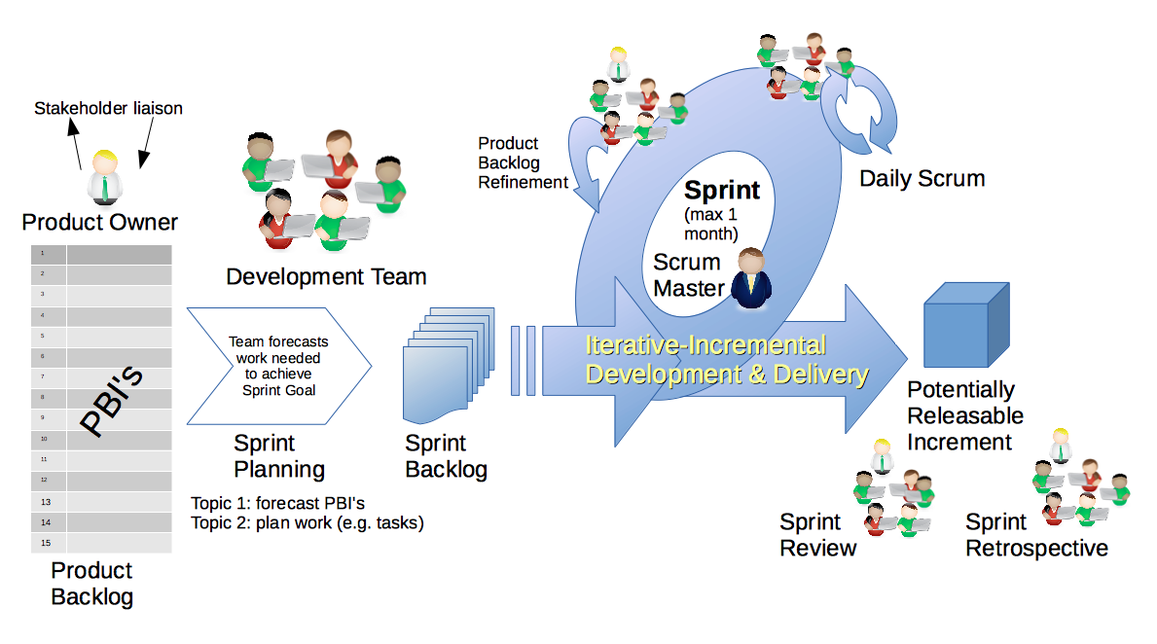
Agile Methods Scrum Process
45

Slide 46
Agile Methods Kanban Development
46
Similar to Scrum, it’s another Agile method focuses on project management.
Developed by Toyota as a manufacturing scheduling system.
Aims to manage work by balancing the demands with available capacity, and improving the handling of system level bottlenecks.
A kanban board is employed to allow a better understanding of work and workflow.
Source: https://en.wikipedia.org/wiki/Kanban_(development)

Slide 47

Agile Methods Kanban Development Kanban vs Scrum
47

Slide 48
Agile Methods Feature-Driven Development
48
Feature-Driven Development (FDD) is an iterative and incremental software development process.
For accurate state reporting and keeping track of the software development project, milestones that mark the progress made on each feature are defined.

Slide 49
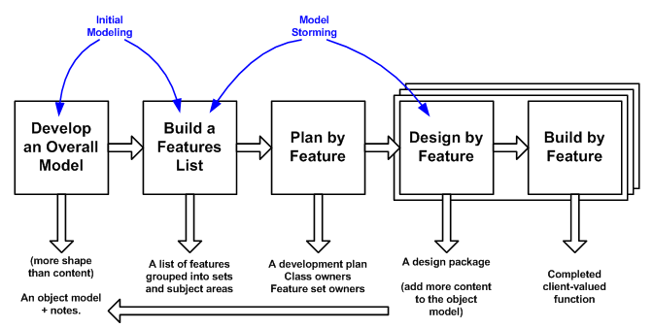
Agile Methods Feature-Driven Development Activities
49
There are five main activities in FDD that are performed iteratively:

Slide 50
Agile Methods Feature-Driven Development Activities
50
1 - Develop An Overall Model:
At the start of a project your goal is to identify and understand the fundamentals of the domain that your system is addressing, and throughout the project you will flesh this model out to reflect what you're building.

Slide 51
Agile Methods Feature-Driven Development Activities
51
2 - Build feature list:
The knowledge that was gathered during the initial modelling was used to identify a list of features. This was done by functionally decomposing the domain into subject areas.
A feature is a small, client-valued function expressed in the form <action><result><object>.

Slide 52
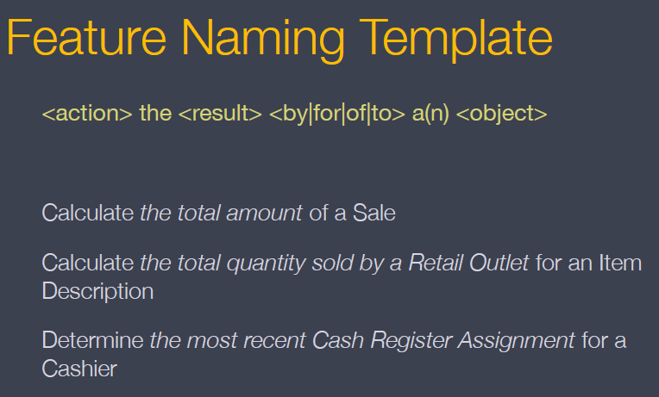
Agile Methods Feature-Driven Development Features
52

Slide 53
Agile Methods Feature-Driven Development Activities
53
3 – Plan by feature:
After the feature list had been completed, the next step was to produce the development plan.
The end result being
a development,
the identification of class owners,
and the identification of feature set owners.

Slide 54
Agile Methods Feature-Driven Development Activities
54
4 – Design by feature:
A design package was produced for each feature.
A chief programmer selected a small group of features that are to be developed within two weeks.
Together with the corresponding class owners, the chief programmer worked out detailed sequence diagrams for each feature and refines the overall model.
Next, the class and method prologues are written and finally a design inspection is held.

Slide 55
Agile Methods Feature-Driven Development Activities
55
5 – Build by feature:
After a successful design inspection a per feature activity to produce a completed client-valued function (feature) is being produced.
The class owners develop the actual code for their classes.
After a unit test and a successful code inspection, the completed feature is promoted to the main build.

